Slide 1
FAC-008 Questionnaire
Informational Session
Mike Hughes
Ash Chappell
Beth Rettig
Notes:
Mike

Slide 2
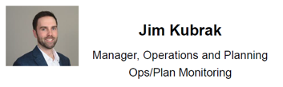
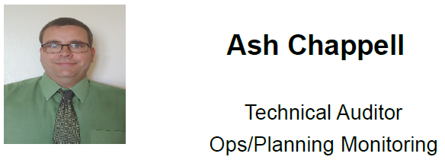
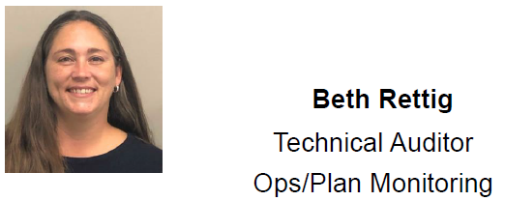
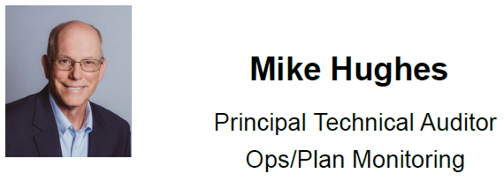
WELCOME
Notes:
Mike to introduce Jim, and Jim discuss high level opening statement

Slide 3
OVERVIEW
Why RF sent out the FAC-008 survey
What is asked in the survey
When the survey was sent and it’s due date
Decisions RF will be making based on the survey
Notes:
Mike

Slide 4
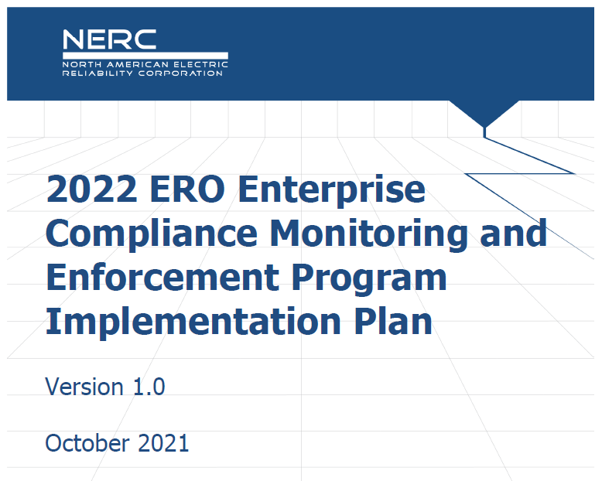
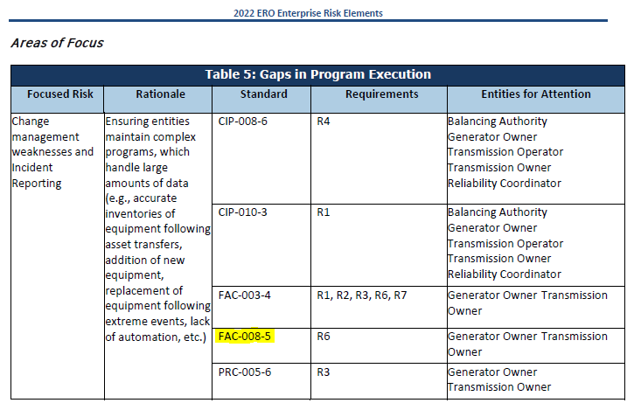
2022 CMEP IP
FAC-008 (Facility Ratings) continues to be an area of focus for the NERC 2022 CMEP IP
FAC-008 is identified in the CMEP IP as a focus area for “Gaps in Program Execution” (see pages 8 & 9 of the CMEP IP)
https://www.nerc.com/pa/comp/CAOneStopShop/ERO%20CMEP%20Implementation%20Plan%20v1.0%20-%202022.pdf
Notes:
Mike
Discuss more of the ‘why’ behind the initiative

Slide 5



The “Why”
RF, NERC and the ERO continue to see gaps in program execution for FAC-008 in Facility Ratings. These gaps include:
  Miscommunication between departments and between entities
  Changes in the field not getting back to the proper channels
  Missing components in the facility ratings database and/or methodology
  User typing and/or rounding errors
  Validating mitigation walkdowns still finding field discrepancies
Notes:
Mike
Common findings behind the ‘why’

Slide 6
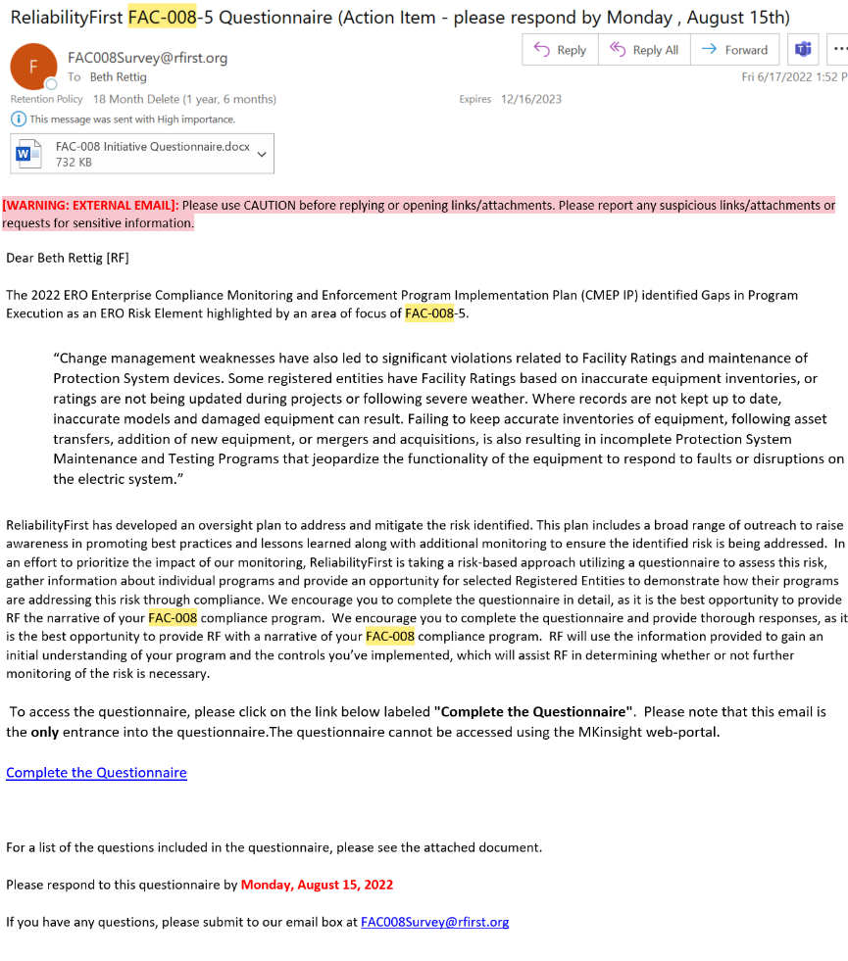
Questionnaire Process and Timeline
Notes:
Beth
The survey will provide RF will an initial look at entities Facility Ratings programs so RF can make an informed decision as how to proceed: audit; spot check; or self-certification; or if the survey provides reasonable assurance that entity is compliant with FAC-008 R6.
Email process/FAC-008survey mailbox
PCC Change
Other Administrative needs

Slide 7
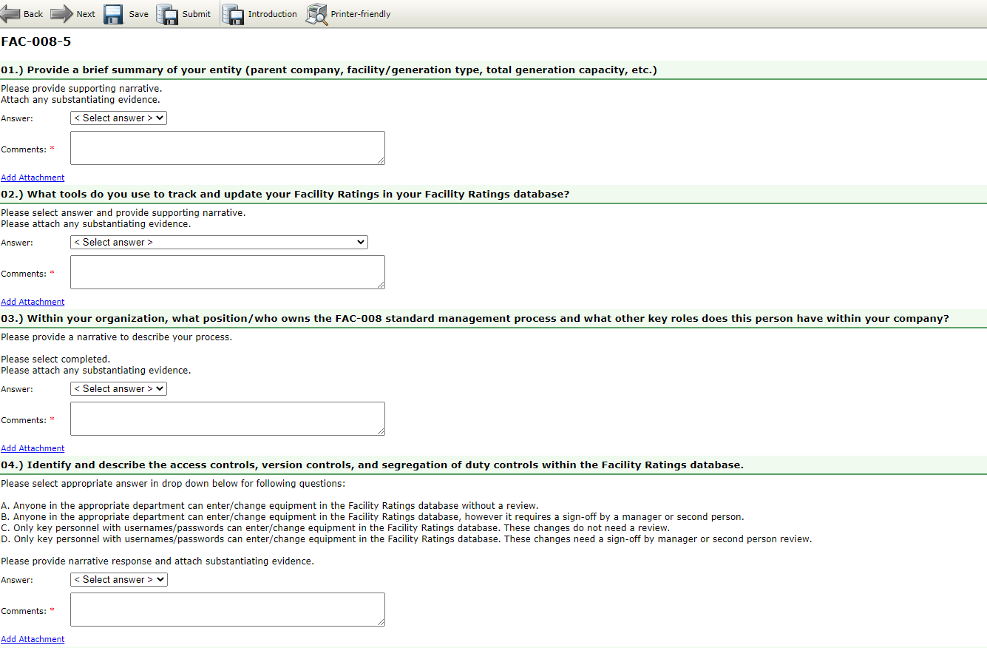
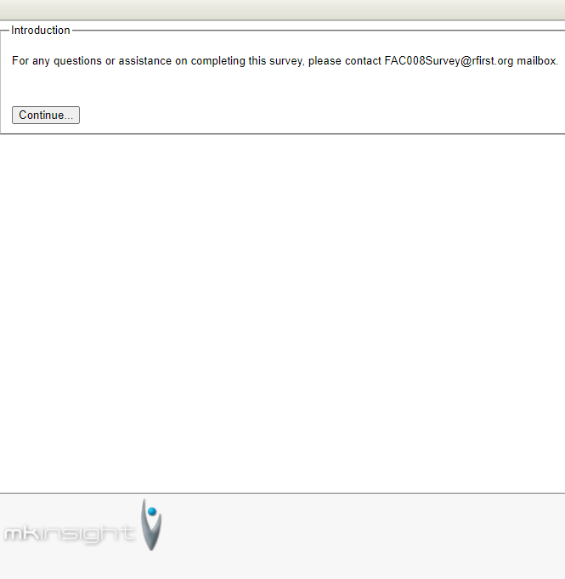
‘Complete the Questionnaire’
Notes:
Beth
Review what the entity will see upon opening the questionnaire link

Slide 8
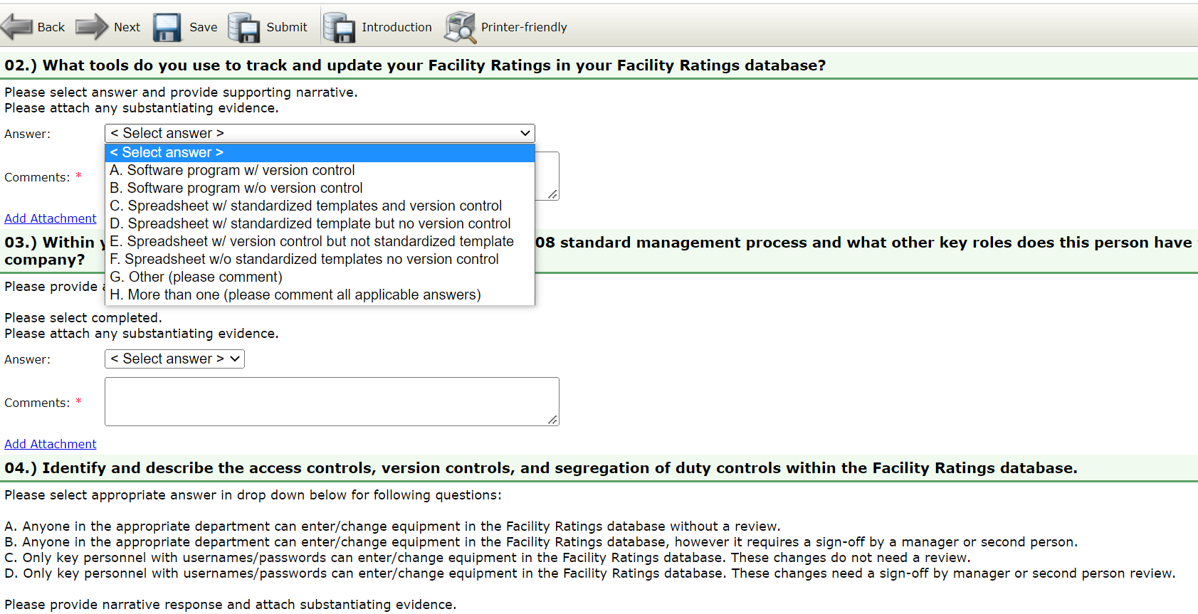
‘Complete the Questionnaire’
Notes:
Beth
Review required fields; what’s in it for them- the more thorough the better in the narrative field supporting the canned answer response

Slide 9
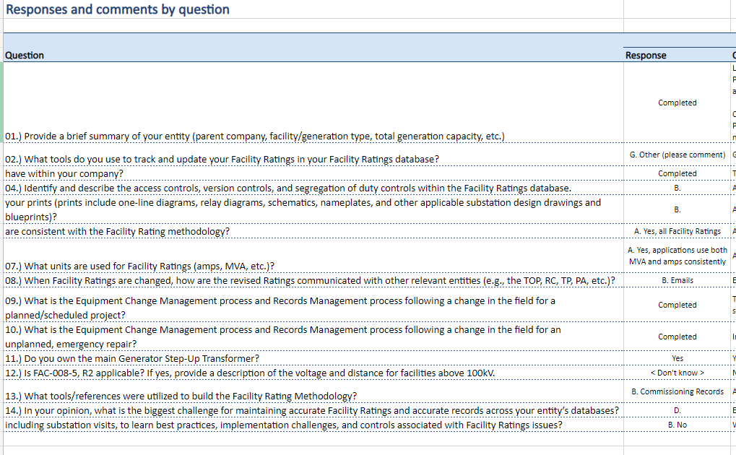
Questionnaire Process and Timeline
Notes:
Beth
Review the RF assessment for completed questionnaires

Slide 10
Questionnaire Process and Timeline
Surveys are due Aug. 15, 2022
RF will review the survey responses in late Q3 and Q4
Self Certifications for this effort will be scheduled throughout the 2023 and 2024 calendar years
Notes:
Beth
After Survey Review, RF will Contact The Entity if additional Monitoring Method Is Determined
For those PCC that have multiple entities, Additional Time can be requested, please reach the RF team via FAC-008 survey mailbox.

Slide 11
Notes:
Beth

